Slide 1
Machine Learning
Interview Questions

Slide 2
1.Why was Machine Learning Introduced?
Machine learning (ML) is a type of artificial intelligence (AI) that allows software applications to become more accurate at predicting outcomes without being explicitly programmed to do so. Machine learning algorithms use historical data as input to predict new output values.

Slide 3
2.What are different types of Machine Learning Algorithms?
There are four types of machine learning algorithms:
Supervised
Semi-supervised
Unsupervised
Reinforcement.

Slide 4
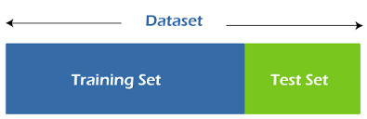
3.What is ‘Training Set’ and ‘Test set’ in a machine learning model? How much Data will you allocate for your Training, Validation, and Test Sets?
The first subset is known as the training data - it's a portion of our actual dataset that is fed into the machine learning model to discover and learn patterns.
The other subset is known as the testing data.

Slide 5
4.What are the Three stages of Building a Model in Machine Learning?
Binary classification
Multiclass classification,
Regression.

Slide 6
5. what are the difference between deep learning and machine learning?
Machine learning describes the capacity of systems to learn from problem-specific training data to automate the process of analytical model building and solve associated tasks.
Deep learning is a machine learning concept based on artificial neural networks.

Slide 7
6.What are the Applications of supervised machine learning in Modern Business?
There are two primary applications for supervised machine learning: classification challenges and regression problems.
Classification is the process of converting an input value to a single value. In classification tasks, we often produce classes or categories as output.
Regression is associated with continuous data. The predicted output values in Regression are actual numbers. It handles issues like projecting the price of a property or the trend in stock prices at a specific moment, among others.

Slide 8
7.What is Semi-Supervised Machine Learning?
Semi-Supervised learning is a type of Machine Learning algorithm that represents the intermediate ground between Supervised and Unsupervised learning algorithms.
It uses the combination of labeled and unlabeled datasets during the training period.

Slide 9
8.What are the Unsupervised Machine Learning Techniques?
Unsupervised learning, also known as unsupervised machine learning, uses machine learning algorithms to analyze and cluster unlabeled datasets.
These algorithms discover hidden patterns or data groupings without the need for human intervention.

Slide 10
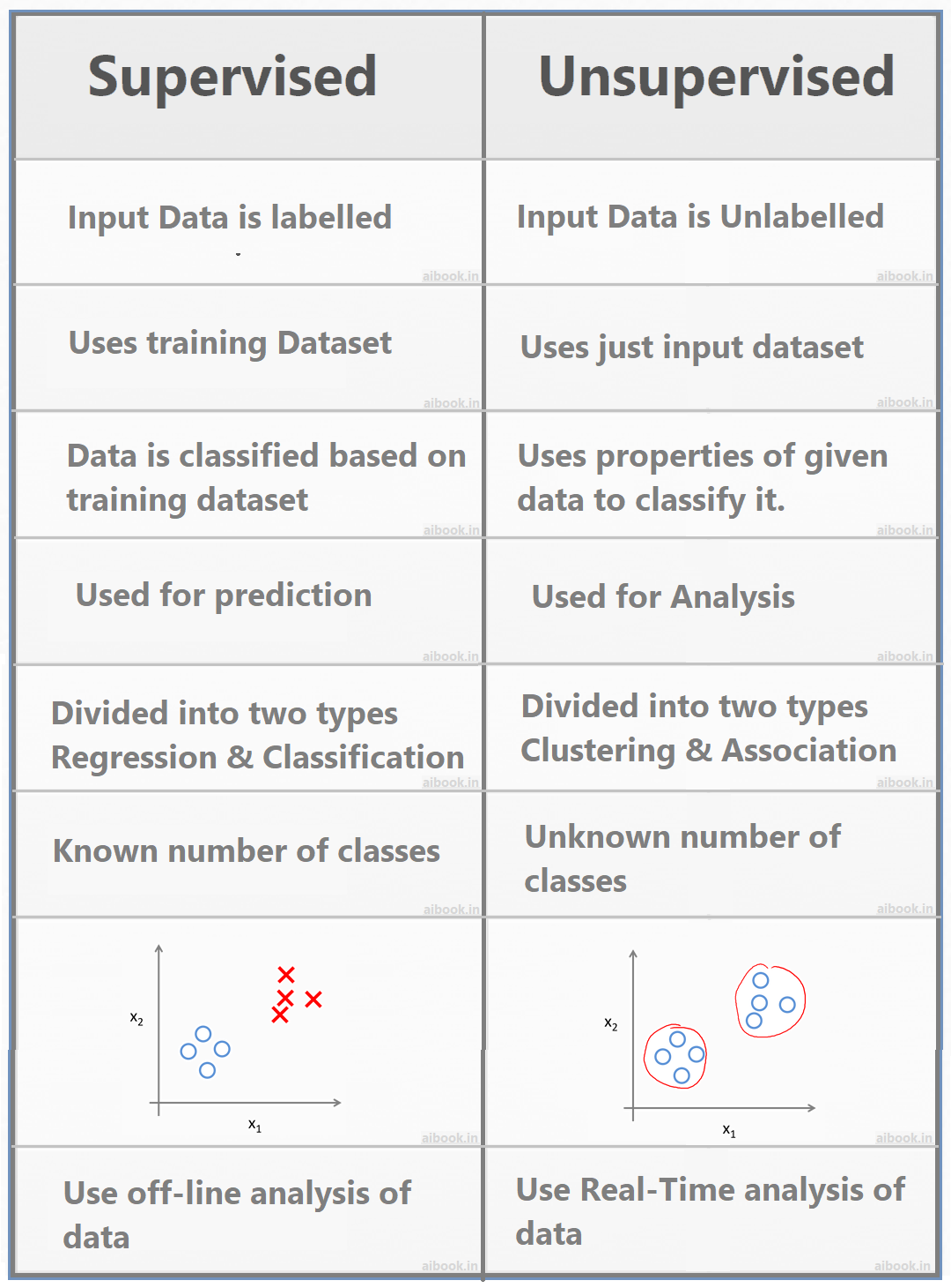
9.Difference between supervised and unsupervised machine learning?

Slide 11
10.What is the difference between Inductive Machine Learning and Deductive Machine Learning?
Inductive reasoning arrives at a conclusion by the process of generalization using specific facts or data.
In inductive reasoning, the truth of premises does not guarantee the truth of conclusions.
Observations-→patterns→hypothesis→Theory.
In inductive reasoning, arguments may be weak or strong.

Slide 12
Deductive reasoning is the form of valid reasoning, to deduce new information or conclusion from known related facts and information.
In deductive reasoning conclusion must be true if the premises are true
Theory→ hypothesis→ patterns→confirmation.
Deductive reasoning reaches from general facts to specific facts.

Slide 13
11.What do u understand by Type-I and Type-II Error?
A Type I error (false-positive) occurs if an investigator rejects a null hypothesis that is actually true in the population.
a Type II error (false-negative) occurs if the investigator fails to reject a null hypothesis that is actually false in the population.

Slide 14
12.What is Ensemble Learning?
Ensemble learning is the process by which multiple models, such as classifiers or experts, are strategically generated and combined to solve a particular computational intelligence problem. Ensemble learning is primarily used to improve the (classification, prediction, function approximation, etc.)

